Slide 1

IT Support Service RMN Syntax Squad
Ryan Stokes
Michal Babik
Nicholas Alves

Slide 2

Overview
Project Scope
Technology Used
Timeline – Gantt Chart
Challenges faced
Database Design
High Level Architecture Diagram
Low Level Design Diagram
Demo

Slide 3

Project Scope
Develop an IT Support service application. The system will include features such as real-time chat, service/ticket requests, troubleshooting guides, IT training cybersecurity resources and data back up and recovery.
This application will operate on a subscription model, where users can pick their packages based on their specific needs and budget.

Slide 4

Technology Used
JavaScript
React
Tailwind
Node JS
MySQL

Slide 5
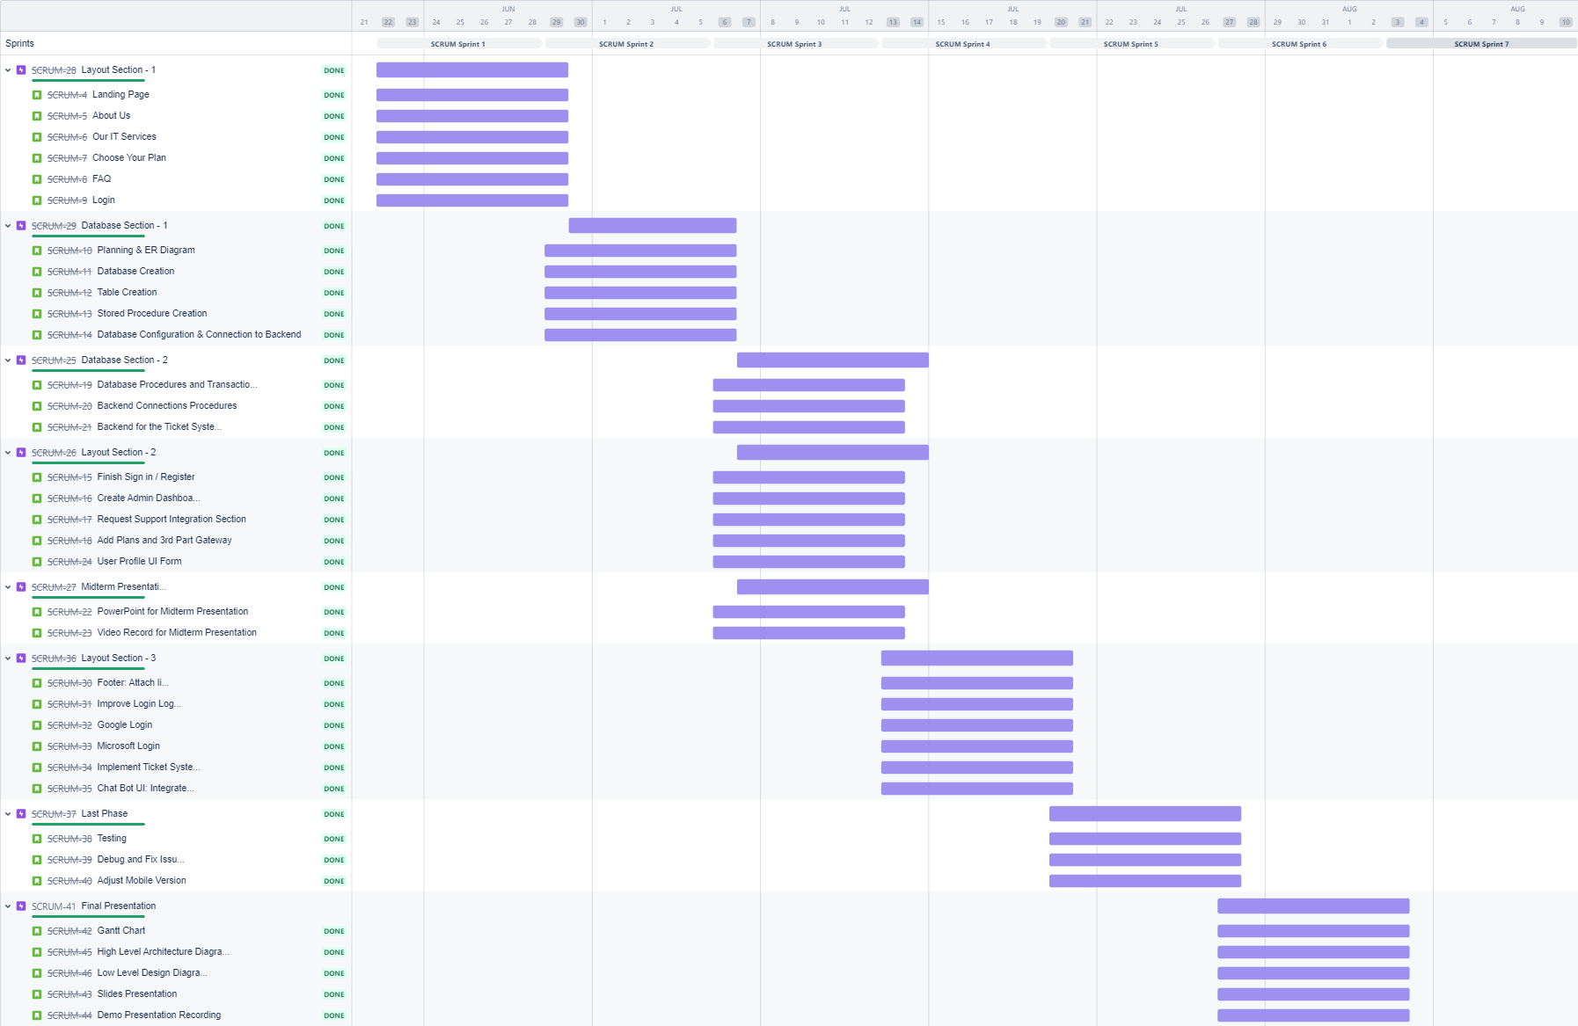
Timeline – Gantt Chart

Slide 6

Challenges Faced
Google/Microsoft OAuth Authentication
Setting up backend APIs to communicate with the front end
Adding Domain
AWS deployment

Slide 7
Database and Architecture Diagrams

Slide 8

Database – Technology Choice
Utilising mySQL for this project
Decided to use mySQL as it fit the needs of the app
Ticketing system requirements called for SQL rather than noSQL
ACID compliance
More structure to handle relationships between entity's
Use of queries to display data

Slide 9
Database Creation
Utilised Aiven hosting services to create and host Database
Connected to hosted database via mySQL workbench
Created tables from ER Diagram

Slide 10
Database Design
Utilises 6 Tables
User, Admin, Tickets, Messages, Support requests and Remote Support Tickets
Currently Optimised through the use of indexes on data used in queries
Future Plans to optimise more through the use of stored procedures

Slide 11
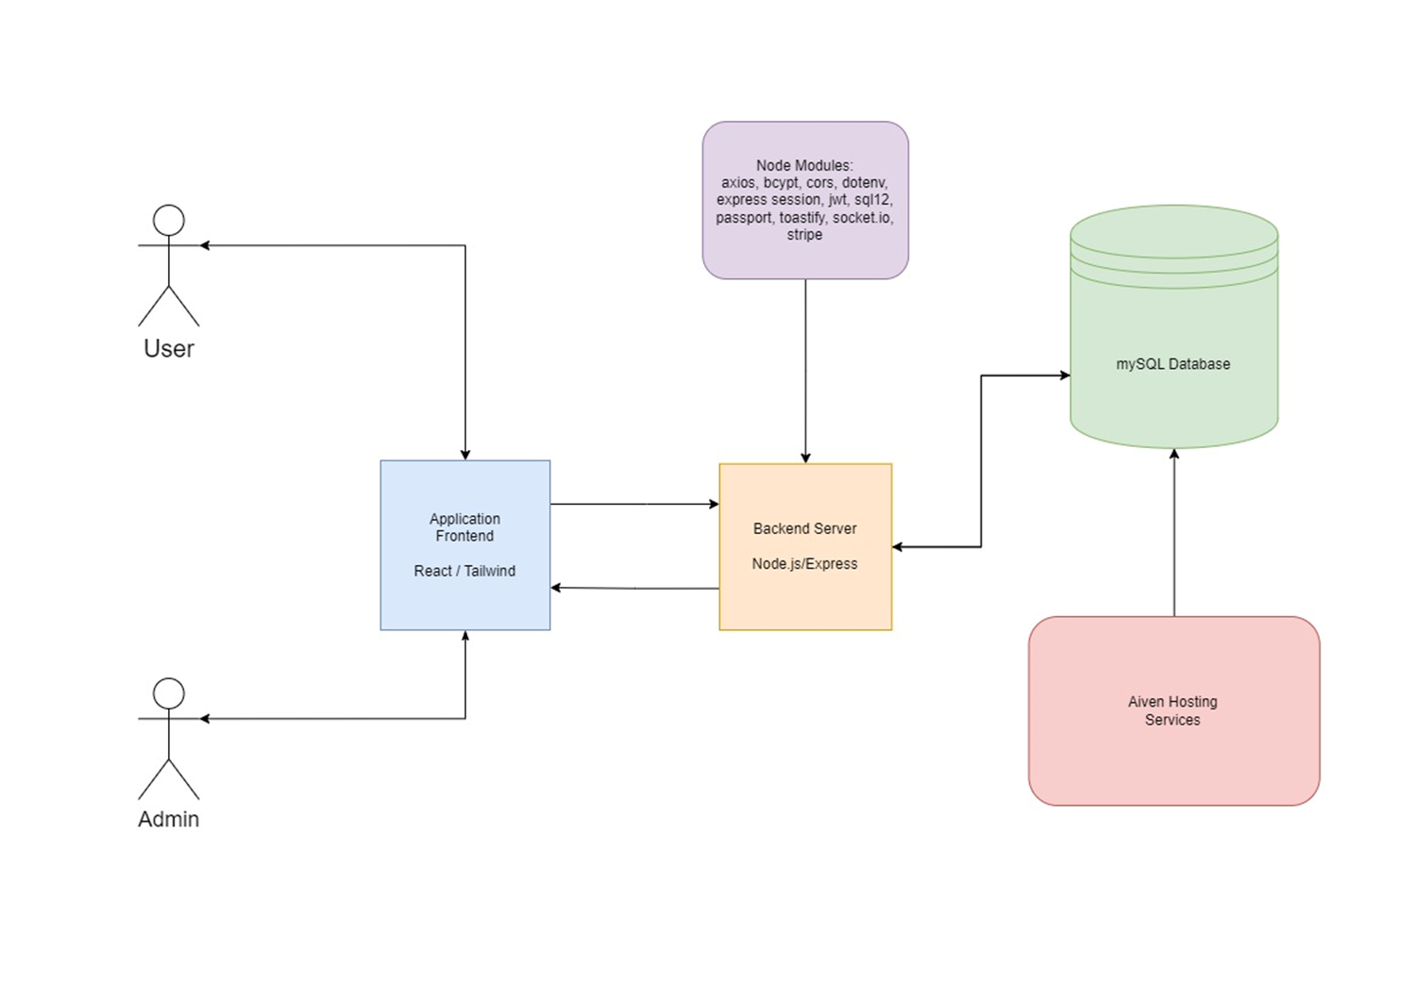
High Level Architecture

Slide 12
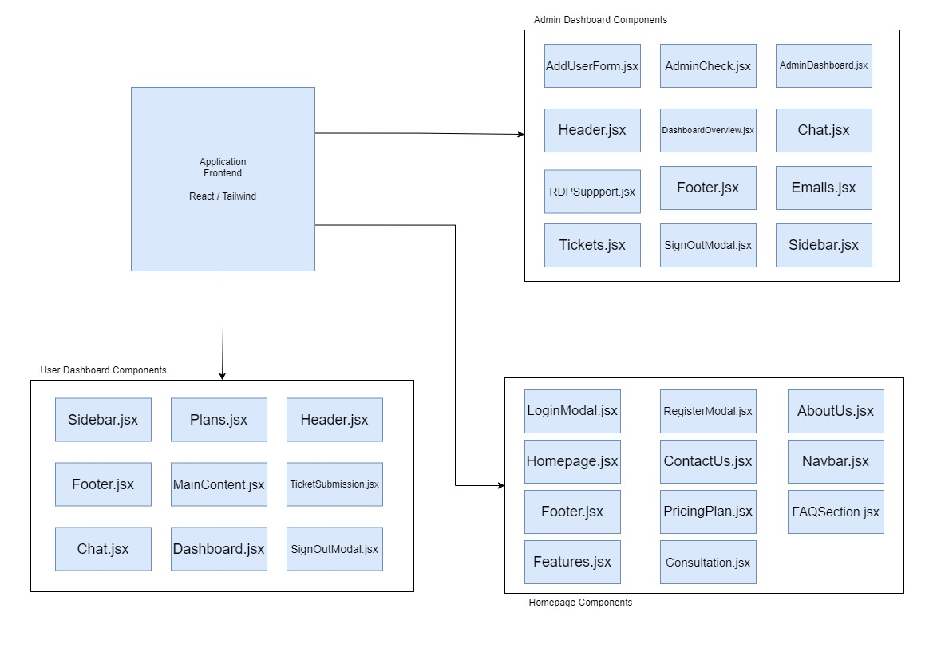
Low Level Architecture - Frontend

Slide 13
Application Demo

